Slide 1
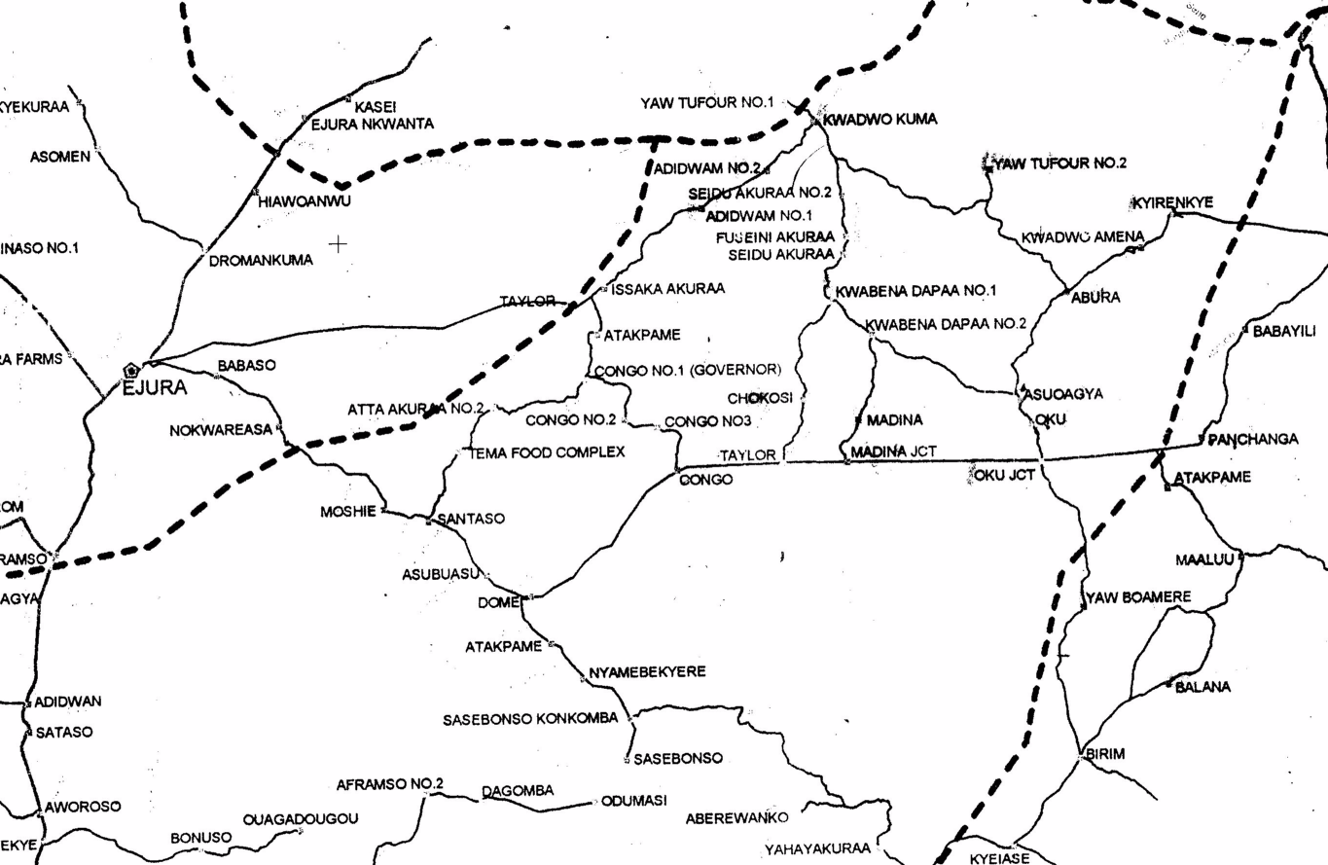
Mainly dry boreholes
Mainly good boreholes
Below adequate boreholes
Mainly good boreholes
Oku Area Reported Groundwater Development

Slide 2
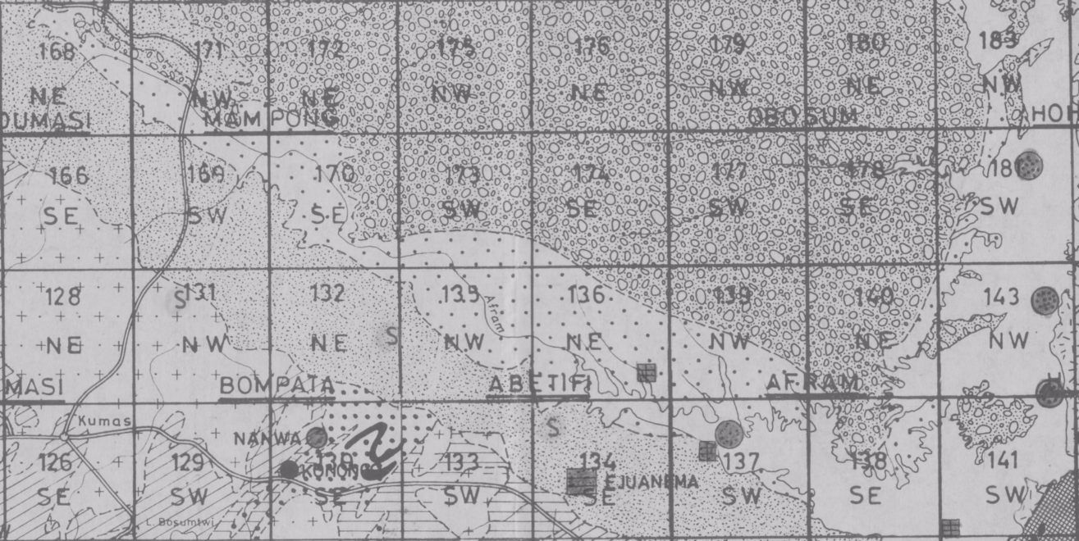
7°30’N
Sandstone and conglomerate Obosum and Oti Beds
7°00’N
Mainly sandstone Obosum and Oti Beds
Shale and mudstone Obosum and Oti Beds
Basement granites and metasediments
6°30’N
1°30’W
1°00’W
0°30’W
0°00’
Afram Plains Geology Map

Slide 3
7°30’N
Ejura-Oku area map
Oku Area
Sandstone and conglomerate Obosum and Oti Beds
7°00’N
Mainly sandstone Obosum and Oti Beds
Shale and mudstone Obosum and Oti Beds
Afram Plains Development area
Basement granites and metasediments
6°30’N
1°30’W
1°00’W
0°30’W
0°00’
Afram Plains Geology and Area Location Map

